Slide 1



BCSC0012
Designing Techniques of Algorithms & Recurrence Relations
Design and Analysis of Algorithms
Dr. Gaurav Kumar
Asst. Prof, CEA
GLA University, Mathura

Slide 2


Why Designing Techniques
  A problem can be solved in various different approaches
  Some approaches deliver much more efficient results than others.
  The algorithm Designing technique is used to
  measure the effectiveness and performance of the
  algorithms.

Slide 3



List of several popular design approaches
What we'll briefly understand today
01
Divide and Conquer Strategy
02
Greedy Technique
03
Dynamic Programming
04
Branch and Bound
05
Backtracking Strategy

Slide 4


Divide and Conquer Strategy
What you should know
01
02
Dividing the problem into sub-problems
Solve every subproblem individually, recursively
03
04
Combining them for the final answer
Follows top-down approach

Slide 5
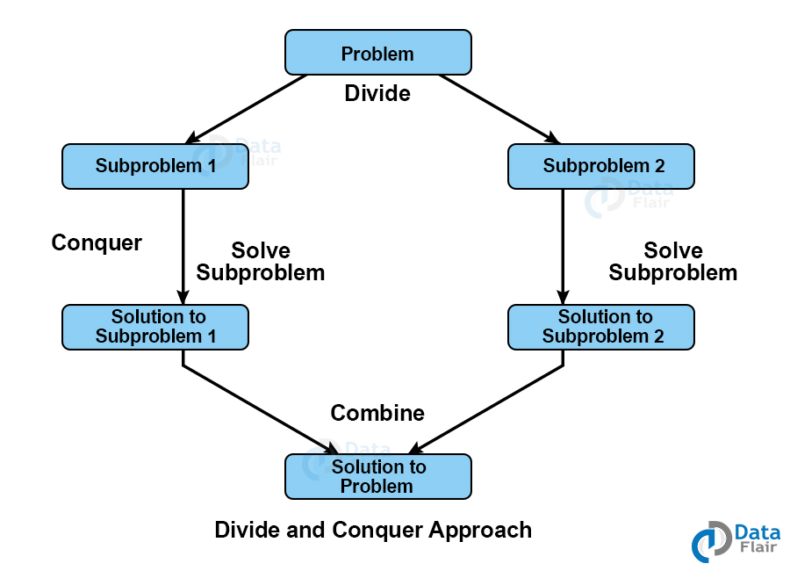
Divide and Conquer Strategy
This technique can be divided into the following three parts:
Divide: This involves dividing the problem into smaller sub-problems.
Conquer: Solve sub-problems by calling recursively until solved.
Combine: Combine the sub-problems to get the final solution of the whole problem.
What you should know
The strategy of designing algorithms has two fundamentals
01
02
Recurrence formula
Stopping Conditions

Slide 6

Divide and Conquer Strategy
What you should know
01
Recurrence Formula/Equation
Function has been defined in terms of same function with some changes in the argument.
02
Stopping Conditions
When you divide the problem by divide and conquer strategy, you need to understand for how long you have to keep dividing. You have to put a stopping condition to stop your recursion steps.

Slide 7



Examples
For Example, the Worst Case Running Time T(n) of the MERGE SORT Procedures is described by the recurrence
0 if n=1
2T(n/2) + O(n) if n>1
T (n) =

Slide 8
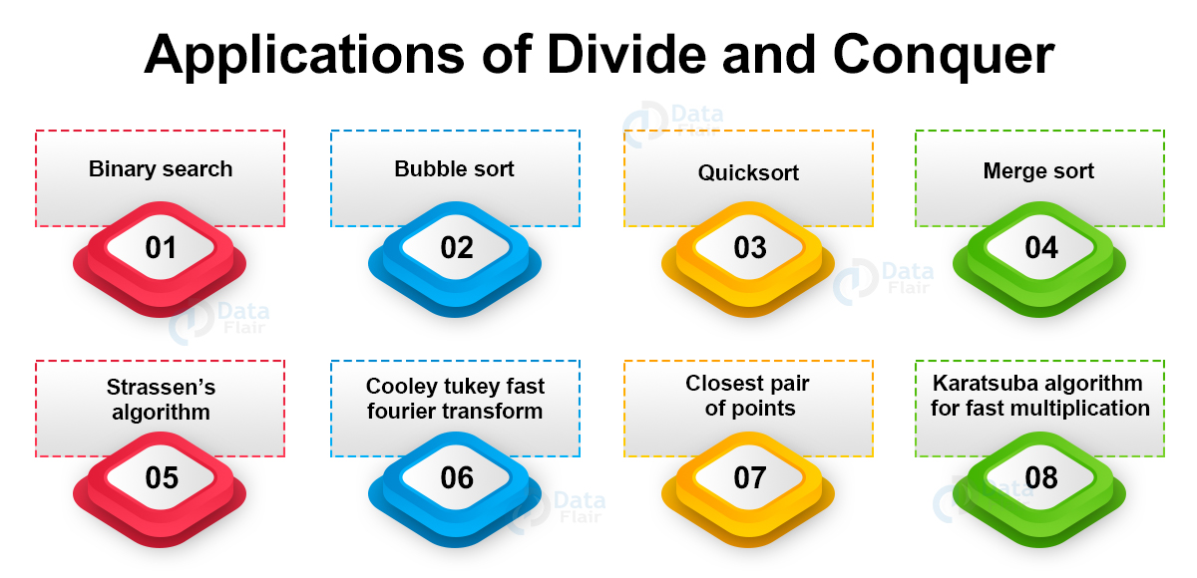
Applications of Divide and Conquer

Slide 9

Advantage of Divide and Conquer Strategy
Divide and conquer successfully solved one of the biggest problems of the mathematical puzzle world, the tower of Hanoi.
You might have a very basic idea of how the problem is going to be solved but dividing the problem makes it easy since the problem and resources are divided.
It Is very much faster than other algorithms.
The divide and conquer algorithm works on parallelism. Parallel processing in operating systems handles them very efficiently.
The divide and conquer strategy used cache memory without occupying much main memory. Executing problems in cache memory which is faster than main memory.

Slide 10
Disadvantage of Divide and Conquer Strategy
Most of the divide and conquer design uses the concept of recursion therefore it requires high memory management.
It may crash the system if recursion is not performed properly.
All iterative nature problems can not be solved using Divide and Conquer strategy, but vice versa is true.

Slide 11
Recursion & Recurrence Relations

Slide 12
What does recursion means
A function calling itself is called recursion & corresponding function is called as recursive function.
fact(int n)
{
if (n < = 1) // base case
return 1;
else
return n*fact(n-1);
}

Slide 13
How recursion works
Example- Sum of first n natural numbers
Approach(1) - Simply adding one by one
Algorithm Sum (A, n)
{
S=0;
for ( i=0; i<n; i++)
{
S= S + A[i];
}
return S;
}
Approach(2) – Recursive adding
Algorithm Sum (n)
{
if(n==1)
return 1;
else
return n + sum(n-1);
}
Sum(n) = n+ sum(n-1)
Sum (5) = 5+4+3+2+1
Sum (5) = 5 + Sum(4)
Sum (4) = 4 + Sum(3)
Sum (3) = 3 + Sum(2)
Sum (2) = 2 + Sum(1)
Sum (1) = 1

Slide 14
What does recursion relation means
1 if n=1
Sum(n-1) + n if n>1
Base/Stopping Condition
Sum (n) =
A recurrence relation is an equation or inequality that describes a function in terms of its values on smaller inputs.
Used to reduce complicated problems to an iterative process based on simpler versions of the problem
T(n) term is used to define the time complexity in recurrence relation analysis.

Slide 15
There are four methods for solving Recurrence
Back Substitution/ Iteration Method
Recursion Tree Method
Master Method
Substitution Method

Slide 16
How to analyze the Recurrence Algorithm
Recursion
Tree Method
Example- Analyze the time complexity of this algorithm
Draw a recurrence tree and calculate the time taken by every level of tree. Finally, we sum the work done at all levels
Algorithm Demo(n)
{
If (n>0)
{
Print “ n”;
Demo(n-1);
}
}
Lets put n=3
Demo(3)
1 Unit of time
Print 3
Demo(2)
1
Print 2
Demo(1)
1
Print 1
Demo(0)
Stopped
T(n)= n → 0(n)
Number of times Print statements is executed = 3
Total number of function call = 3+1

Slide 17

How to write and solve a Recurrence Equation
Example- Analyze the time complexity of this algorithm
Algorithm Demo(n)
{
If (n>0)
{
Print “ n”;
Demo(n-1);
}
}
T(n)
1
T(n-1)
1 if n=0
T(n-1) + 1 if n>0
T (n) =
T(n)= T(n-1) + 1

Slide 18
How to write and solve a Recurrence Equation
Iteration Method
(Back Substitution/ Iteration Method)
Expand the recurrence by solving the smaller terms and express it as a summation of terms of n and initial condition.
Recall this equation
S(n) = n+ s(n-1)
If I know s(n-1),
then I can easily calculate s(n)
T(n)= T(n-1) + 1
(1)
Calculate the T(n-1) and then
substitute the value
Put n= n-1 in Equation (1)
T(n-1)= T((n-1)-1) + 1
= T(n-2) + 1
Substitute back
We know that T(0)=1
(base Condition)
T(n)= T(n-2) + 1+1
Assume that n-k=0
Then k=n
Put n= n-2 in Equation (1)
T(n-2)= T((n-2)-1) + 1
= T(n-3) + 1
T(n)= T(0) + k*1
T(n)= T(n-3) +1+ 1+1
T(n)= 1 + n
Continued for k times
T(n)= T(n-k) + k*1
T(n)= O(n)

Slide 19

How to write and solve a Recurrence Equation
Master Method (cookbook method)
Master Method is a direct way to get the solution.
The master method works for following type of recurrences or for recurrences that can be transformed to following type. (*)
1 if n=0
T(n-1) + 1 if n>1
T(n) = aT(n/b) + f(n)
where a >= 1 and b >= 1
T (n) =
(*) we can also derive the master theorem for decreasing function.

Slide 20
How to analyze the Recurrence Algorithm
Substitution Method
We make a guess for the solution and then we use mathematical
induction to prove the guess is correct or incorrect
1 if n=0
T(n-1) + 1 if n>0
We guess the solution as T(n) = O(n)
Now we use mathematical induction to prove our guess. We need to prove that T(n) <= cn for all value of n>=n_{o} and c>0
T (n) =
T(n) = T(n-1) + 1
= c(n-1) + 1 = cn-c+1 = cn+1-c
T(n)= cn+1-c <= cn for all c>=1
Lets Put c=1 1*n+1-1<= 1*n n=n
Put c=2 2*n+1-2<=2*n
2n-1 < 2n

Slide 21
How to analyze the Recurrence Algorithm
Lets put n=3
Recurrence Tree Method
Algorithm Demo(n)
{
If (n>0)
{
for (i=0; i<n; i++)
{
print “ n”;
}
Demo(n-1);
}
}
T(n)
Demo(3)
3
3
Demo(2)
2
2
Demo(1)
1
n
T(n-1)
1
Demo(0)
Stopped
Recurrence Relation
T(n)= T(n-1) + n
Number of times Print statements is executed =1+2+3
Total number of function call = 3+1
For n elements, number of times Print statements is executed =1+2+3+4+5+…+n =n(n+1)/2 = n²
T(n)= O(n²)

Slide 22
How to analyze the Recurrence Algorithm
Iterative Method
1 if n=0
T(n-1) + n if n>0
Recurrence Relation
T (n) =
(Base Equation)
Put n= n-1
T(n-1)= T((n-1)-1) + n-1
=T(n-2) + n-1
T(n)= T(n-k) +n-(k-1) + n-(k-2) +…n-1 + n
For n=0, T(0)=1, i.e. n-k=0 -> n=k
T(n)= T(0) + n-(n +1)+ n-(n-2) + …..n-1 + n
= T(0) + 1 + 2+ 3+ ......n-1 + n
= T(0) + n (n+1)/2
= 1 + (n² + n)/2
= O(n²)
T(n)= T(n-2) + n-1 + n
Put n= n-2 in the base equation
T(n-2)= T((n-2)-1) + n-2
= T(n-3) + n-2
T(n)= T(n-3) +n-2 + n-1 + n
= T(n-4)+ n-3 + n-2+ n-1+ n
Continued for k times
T(n)= T(n-k) +n-k+1 + n-k+2 +…n-1 + n
T(n)= O(n²)

Slide 23
How to analyze the Recurrence Algorithm
Lets put n=3
Recurrence Tree Method
Algorithm Demo(n)
{
If (n>0)
{
print “ n”;
Demo(n-1);
Demo(n-1);
}
}
T(n)
Demo(3)
1
Print 3
Demo(2)
Demo(2)
2
1
T(n-1)
Print 2
Demo(1)
Demo(1)
2
Demo(1)
Demo(1)
4 = 2²
T(n-1)
Print 1
Demo(0)
Demo(0)
. . .. . ..
1
Demo(0)
Demo(0)
Recurrence Relation T(n)= 2T(n-1) + 1
Stopped
Stopped
Stopped
Stopped
Number of times Print statements is executed =1+2+2²
For n elements, number of times Print statements is executed =1+2+2²+ 2³ + 2⁴ + …+2^{n} =2^{n+1} -1 = 2^{n}
T(n)= O(2^{n})
Using GP Series formula: a+ ar² + ar³ + ar⁴ +….ar^{n}= ar^{n+1}-1/r-1

Slide 24
How to analyze the Recurrence Algorithm
Recurrence Relation
T(n)= 2T(n-1) + 1 for n>0
= 1 for n=0
Iteration Method
T(n)= 2T(n-1) + 1
Put T(n-1)= 2T(n-2) + 1
= 2 ( 2T(n-2) +1) +1
Put T(n-2)= 2T(n-3) + 1
= 2² T(n-2) + 2 + 1
= 2² (2T(n-3) + 1 )+ 2 + 1
= 2³ T(n-3) + 2² + 2 + 1
.
.
.
= 2^{k} T(n-k) + 2^{k-1} + ….. 2² +2 + 1
For n=0, T(0)=1, it means that n-k=0 → n=k
2^{n} + 2^{n-1} + ….. 2² +2 + 1 = 2^{n+1} -1 = O(2^{n})

Slide 25
Quick Revision of Time Complexity
(Decreasing Functions)
T(n)= T(n-1) + 1 for n>0
= 1 for n=0
T(n)= O(n)
T(n)= T(n-1) + n for n>0
= 1 for n=0
T(n)= O(n²)
T(n)= 2T(n-1) + 1 for n>0
= 1 for n=0
T(n)= O(2^{n})
T(n)= 2T(n-1) + n for n>0
= 1 for n=0
T(n)= O(n. 2^{n})

Slide 26
How to analyze the Recurrence Algorithm
Recurrence Tree Method
(Dividing Functions)
Demo(n)
1
Algorithm Demo(n)
{
If (n>1)
{
Print “ n”;
Demo(n/2);
}
}
T(n)
Print n
Demo(n/2)
1
Print n/2
Demo(n/2²)
1
k level
1
Print n/2²
Demo(n/2³)
1
T(n/2)
.
.
.
k times
Stopping Condition: n/2^{k}=1
= n=2^{k}
= k= logn = T(n)= O(logn)
Print n/2^{k}
Demo(n/2^{k})
1

Slide 27
a = 8, b=2, f (n) = 1000 n², log_{b}a = log₂8 = 3 Put all the values in: f (n) = 1000 n² = O (n^{3-ε} ) If we choose ε=1, we get: 1000 n² = O (n³⁻¹) = O (n²)
a = 8, b=2, f (n) = 1000 n², log_{b}a = log₂8 = 3
How to analyze the Recurrence Algorithm
(Dividing Functions)
Iterative Method
Recurrence Relation
T(n)= T(n/2) + 1 for n>1
= 1 for n=1
T(n)= T(n/2) + 1
=T(n/2²) +1 +1
= T(n/2³) +1 +1 +1
.
.
.
= T(n/2^{k}) + K*1
T(n) =T(1) + k
= 1+k
= logn+1
= O(logn)
Put n=n/2
T(n/2) = T(n/2²) +1
T(n)= O(logn)
put n/2^{K}=1
= n=2^{K}
=k= logn

Slide 28
How to analyze the Recurrence Algorithm
Recurrence Relation
T(n)= 2T(n/2) + n for n>1
= 1 for n=1
(Dividing Functions)
T(n)
1*n
=n
n
T(n/2)
T(n/2)
2*n/2
=n
K
n/2
T(n/2²)
T(n/2²)
n/2
T(n/2²)
T(n/2²)
2²*n/2²
=n
2³*n/2³
n/2²
T(n/2³)
T(n/2³)
. . .. . ..........................
n/2²
T(n/2³)
=n
T(n/2³)
. . .. . ......
. . .. . .......
2^{k}*n/2^{k}
=n
n/2^{k}
T(n/2^{k})
T(n/2^{k})
n/2^{k}
T(n/2^{k})
T(n/2^{k})
. . .. . ..
Stopped
Stopped

Slide 29
How to analyze the Recurrence Algorithm
(Dividing Functions)
Recurrence Relation
T(n)= 2T(n/2) + n for n>1
= 1 for n=1
T(n)= n + n+ n+ n+ n+ ……+ n ( k times)
= n*k
or
T(n)= number of level or height of tree * time taken at each level
= k* (n)
= n*k
As we know that stopping condition
n/2^{k}=1
n=2^{k} (apply log)
=> k = logn
T(n)= n* logn

Slide 30
How to analyze the Recurrence Algorithm
Recurrence Tree Method
(Dividing Functions)
T(n)
n
Recurrence Relation
T(n)= T(n/2) + n for n>1
= 1 for n=1
n
T (n/2)
n/2
n/2
T(n/2²)
n/2²
k level
T(n)= n + n/2 + n/2²+ n/2³+ …..+ n/2^{K}
= n (1+1/2 + 1/2² +1/2³……….+ 1/2^{k})
=n*1
=O(n)
n/2²
T(n/2³)
n/2³
.
.
.
k times
n/2^{k}
T(n/2^{k})
n/2^{k}

Slide 31
How to analyze the Recurrence Algorithm
(Dividing Functions)
Recurrence Relation
T(n)= 2T(n/2) + c for n>1
= 1 for n=1
T(n)
c
T (n/2)
T (n/2)
2*c
T(n)= c + 2*c + 2²*c + 2³*c + ……+ 2^{k}*c
= c (1+2 + 2² +2³……….+ 2^{k})
= c (2^{k+1}-1)
= c* 2^{k}
put k =logn
= c* 2 ^{logn}
= c*n (2 ^{logn} = n^{log2})
T(n)= O(n)
T(n/2²)
T(n/2²)
T(n/2²)
T(n/2²)
2²*c
.
.
.
T(n/2³)
T(n/2³)
T(n/2³)
T(n/2³)
2³*c
.
.
.
k times
As we know that stopping condition
n/2^{k}=1
n=2^{k} (apply log)
=> k = logn
.
.
.
T(n/2^{k})
T(n/2^{k})
T(n/2^{k})
T(n/2^{k})
2^{k}*c

Slide 32
Quick Revision of Time Complexity
(Dividing Functions)
T(n)= T(n/2) + 1 for n>1
= 1 for n=1
T(n)= O(logn)
T(n)= 2T(n/2) + n for n>1
= 1 for n=1
T(n)= O(nlogn)
T(n)= T(n/2) + n for n>1
= 1 for n=1
T(n)= O(n)
T(n)= 2T(n/2) +c for n>1
= 1 for n=1
T(n)= O(n)

Slide 33
How to analyze the Recurrence Algorithm (Dividing Functions)
Master Method (cookbook method)
Master Method is a direct way to get the solution.
The master method works for following type of recurrences or for recurrences that can be transformed to following type. (*)
T(n) = aT(n/b) + f(n)
n = size of input , a = number of sub-problems in the recursion , n/b = size of each sub-problem.
f(n) = cost of the work done outside the recursive call, which includes the
cost of dividing the problem and cost of merging the solutions
Here, a ≥ 1 and b > 1 are constants, and f(n) is an asymptotically positive function.

Slide 34
How to analyze the Recurrence Algorithm (Dividing Functions)
Master Method (cookbook method)
T(n) = aT(n/b) + f(n)
_{Calculate} _{n}log_{b}a
_{If f(n) > n}log_{b}a Then T(n) = O(f(n))
Case -1
_{If f(n) < n}log_{b}a _{Then T(n) = O(n}log_{b}a₎
Case -2
_{If f(n) = n}log_{b}a _{Then T(n) = O(n}log_{b}a _{logn) or O(f(n)* logn)}
Case -3

Slide 35
How to analyze the Recurrence Algorithm
(Using Mater Theorem)
Solve it using Master Theorem
T(n) = aT(n/b) + f(n)
Example -1
T(n)= 2T(n/2) + n for n>1
= 1 for n=1
T(n)= O(nlogn)
a=2, b=2, f(n) = n
_{Calculate} _{n}log_{b}a
n^{log} 2² = n
Case -3
_{If f(n) = n}log_{b}a
_{Then T(n) = O(f(n)* logn)}
f(n) = n is given
Hence, T(n) = O(f(n)*Logn)
= O(n*logn)
Case-3 condition satisfied

Slide 36
Examples Exercise of Master Theorem
Master Theorem
T(n) = a T(n/b) + f(n)
Example -2
T(n) = 4T(n/2) + n³
a=4, b=2, f(n) = n³
Example -3
T(n) = 7T(n/2) + n²
_{Calculate} _{n}log_{b}a
= n^{log} 2⁴ = n²
a=7, b=2, f(n) = n²
f(n) = n³ is given
_{Calculate} _{n}log_{b}a
= n^{log} 2⁷
Case-1 condition is satisfied
Hence, T(n) = O(f(n))
= O(n³)
f(n) = n² is given
Case-2 condition is satisfied
Hence, T(n) = O(n^{log}bª)
= O(n^{log} 2⁷)

Slide 37
Examples Exercise of Master Theorem
Master Theorem
T(n) = a T(n/b) + f(n)
Example -4
T(n) = T(n/4) + n
Example -5
a=1, b=4, f(n) = n
T(n) = 4T(7n/3 + 5 ) + n²
_{Calculate} _{n}log₄1
= n⁰ = 1
a=4, b=3/7, f(n) = n²
f(n) = n is given
_{Calculate} _{n}log_{b}a
= n^{log 43/7}
Case-1 condition is satisfied
Hence, T(n) = O(f(n)
= O(n)
f(n) = n² is given
Case-1 condition is satisfied
Hence, T(n) = O(f(n))
= O(n²)

Slide 38
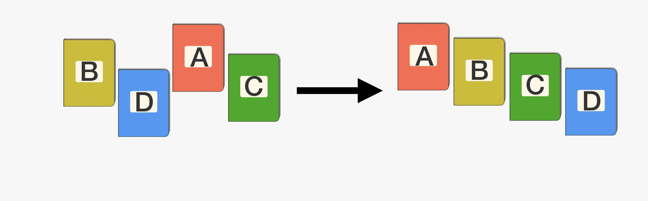
Analysis of Sorting Algorithms

Slide 39
1. Insertion Sort Algorithm

Slide 40
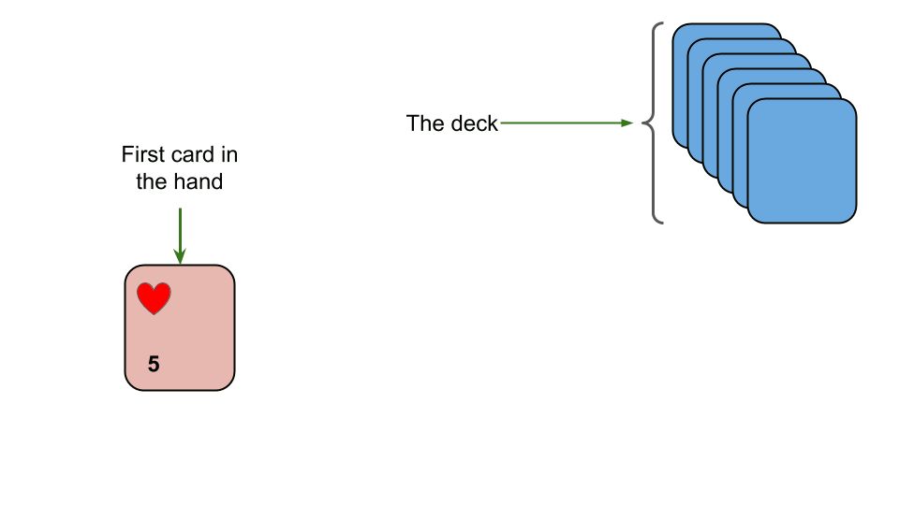
1. Insertion Sort Algorithms
Insertion sort is a simple sorting algorithm that works similar to the way you sort playing cards in your hands.
The array is virtually split into a sorted and an unsorted part.
Values from the unsorted part are picked and placed at the correct position in the sorted part.

Slide 41
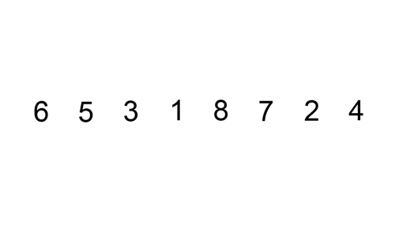
Understanding Insertion Sort
Step 1 - If the element is the first element, assume that it is already sorted. Return 1.
Step2 - Pick the next element, and store it separately in a key.
Step3 - Now, compare the key with all elements in the sorted array.
Step 4 - If the element in the sorted array is smaller than the current element, then move to the next element. Else, shift greater elements in the array towards the right.
Step 5 - Insert the value.
Step 6 - Repeat until the array is sorted.
To sort an array of size n in ascending order

Slide 42
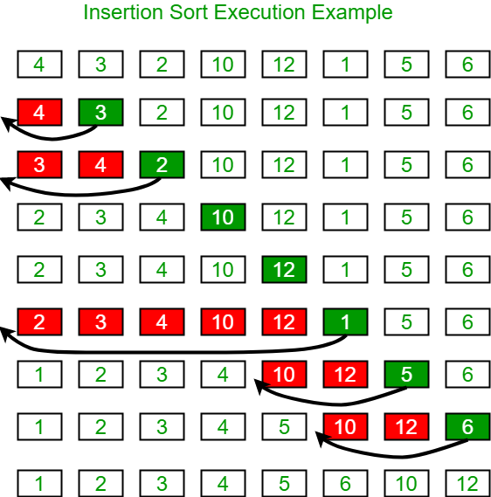
Analysis of Insertion Sort
void insertionSort(int arr[], int n)
{
int i, key, j;
for (i = 1; i < n; i++) {
key = arr[i];
j = i - 1;
/* Move elements of arr[0..i-1], that are
greater than key, to one position ahead
of their current position */
while (j >= 0 && arr[j] > key)
{
arr[j + 1] = arr[j];
j = j - 1;
}
arr[j + 1] = key;
}
}

Slide 43
Analysis of Insertion Sort
Best Case (Already Sorted) (Ex- 1,2,3,4,5)
Total Number of Comparison – 1 + 1 + 1 + 1 +… n Times = n
Total Number of Shifting = 0
Total Time = Total Number of Comparison + Total Number of Shifting = 0+n=n
Time Complexity= O(n)
Worst Case
(Completely Not Sorted) (Ex- 5,4,3,2,1)
Total Number of Comparison – 1 + 2 + 3 + 4 +… n = n (n+1)/2 = n²
Total Number of Shifting = 1 + 2 + 3 + 4 +… n = n (n+1)/2 = n²
Total Time = Total Number of Comparison + Total Number of Shifting = n²+n²=2n²
Time Complexity= O(n²)

Slide 44
Analysis of Insertion Sort
Average Case (Jumbled Order)
(Example of Snapshot)
Total Time = Total Number of Comparison + Total Number of Shifting
Avg Time Complexity= O(n²)

Slide 45
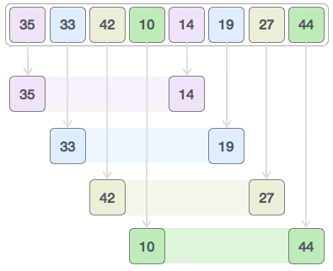
2. Shell Sort Algorithms
Step-1 Make a virtual sub-list of all values located at the interval of 4 positions. Here these values are {35, 14}, {33, 19}, {42, 27} and {10, 44}
Shell sort is a generalized version of the insertion sort algorithm
It first sorts elements that are far apart from each other and successively reduces the interval between the elements to be sorted.
The interval between the elements is reduced based on the sequence used.

Slide 46

2. Shell Sort Algorithms
Step -2 We compare values in each sub-list and swap them (if necessary) in the original array. After this step, the new array should look like this −
Step- 3 Then, we take interval of 1 and this gap generates two sub-lists - {14, 27, 35, 42}, {19, 10, 33, 44}

